Slide 1
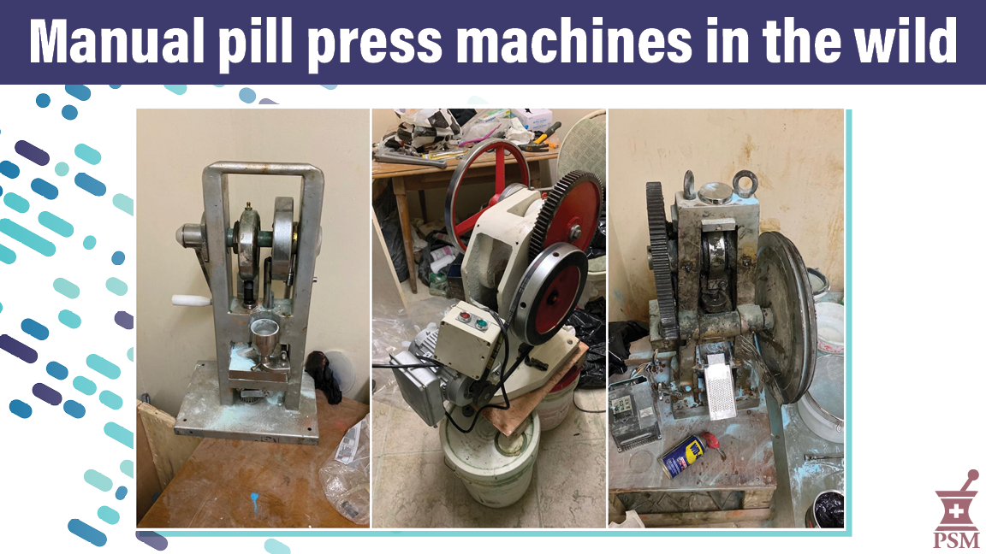
Notes:
These are low-end pill press machines. The left one is completely manual. They are photographed by law enforcement in their seizure location. The lack of cleanliness in these illegal labs is a clear safety hazard.

Slide 2
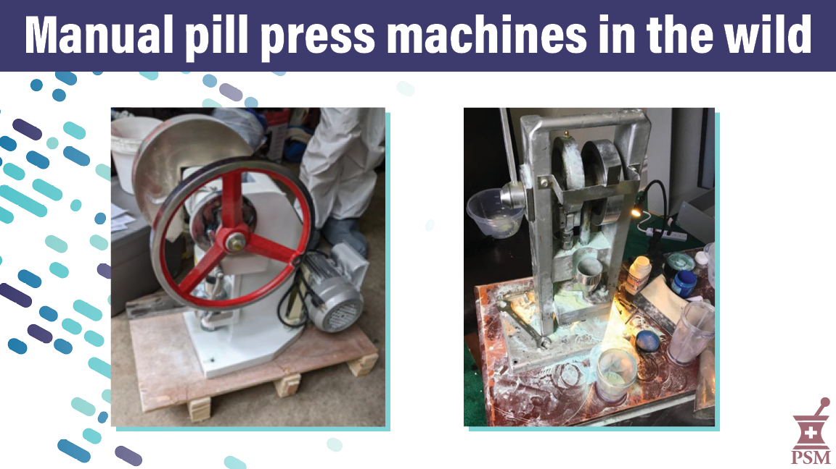
Notes:
These are low-end manual pill press machines. They are photographed by law enforcement in their seizure location. The lack of cleanliness in these illegal labs is a clear safety hazard.

Slide 3
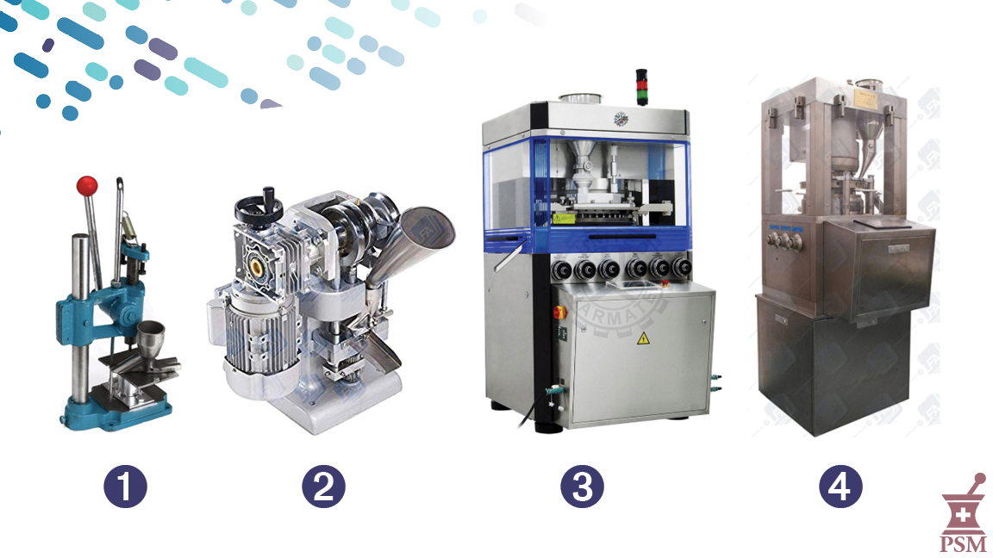
Notes:
This is an array of machines from low end low volume manual on the left to the machines on the right that can create hundreds of thousands of pills quickly.

Slide 4
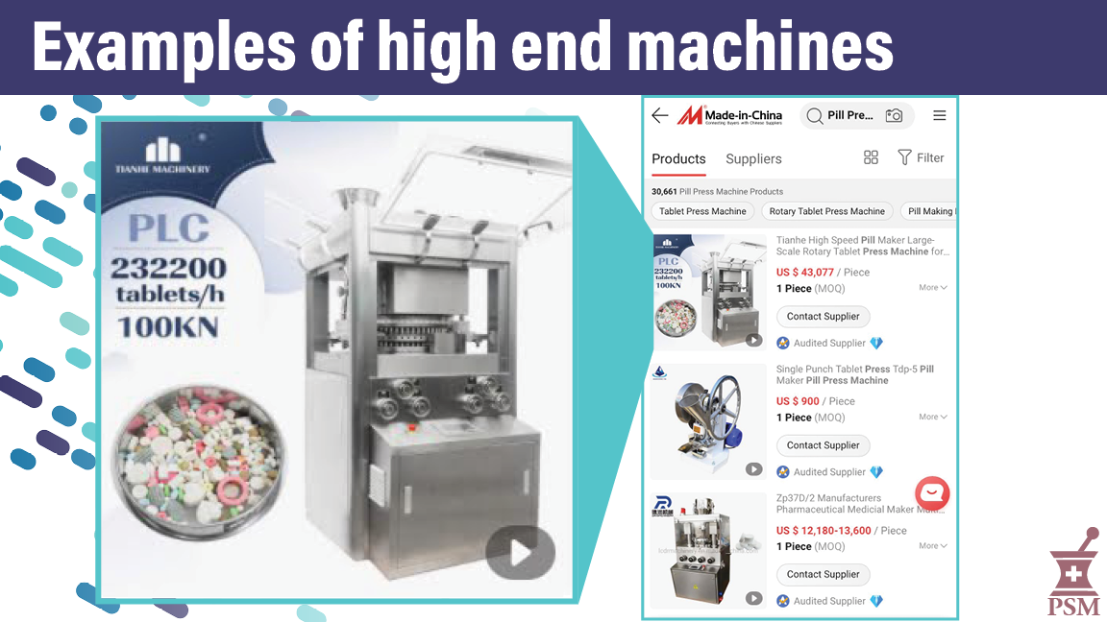
Notes:
High end pill press machine for sale online. Can make >200,000 pills per hour.

Slide 5
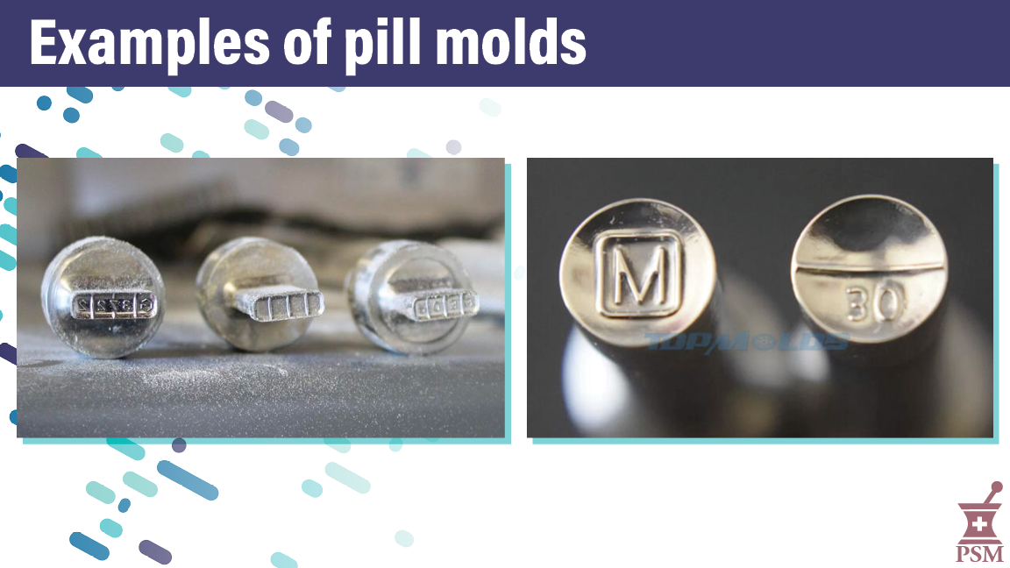
Notes:
Pill press molds are used to press the powder into the shape of the pill. They are typically trademarked so buying, selling, and using them is both a criminal and civil violation.

Slide 6

Notes:
PSM published an update every six months about developments in pill press policy and seizure numbers.

